Slide 1
ROS
Robot Modelling/Visualisation Tools

Slide 2
Robot Descriptions
URDF Files

Slide 3
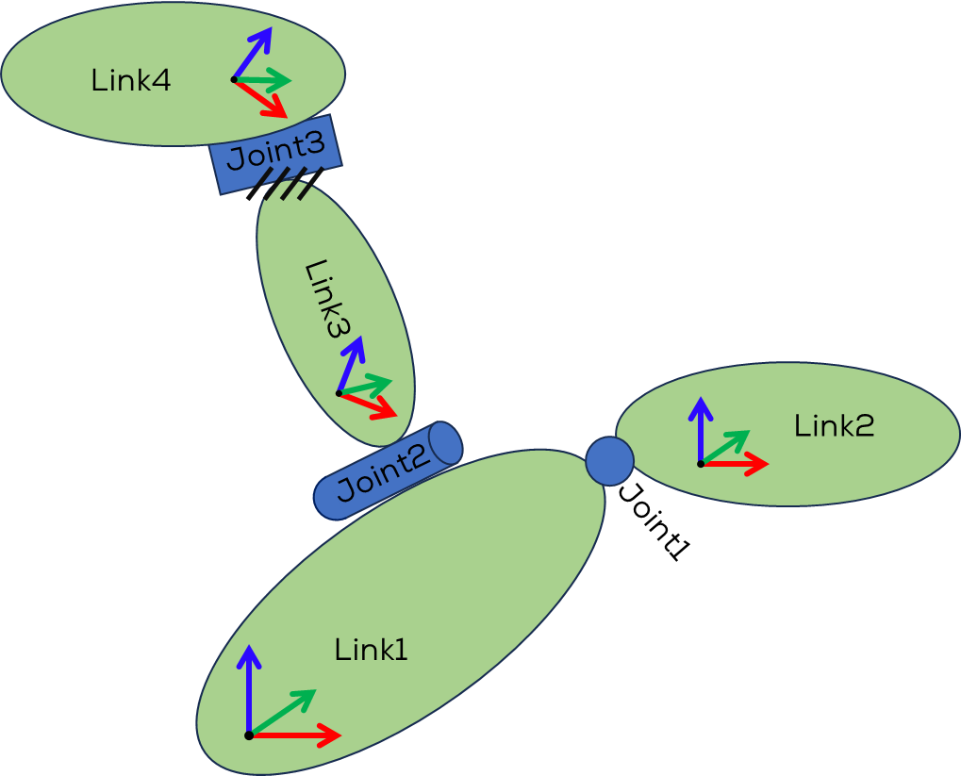
URDF Files
URDF (Unified Robot Description Format) files are XML-based files used to describe a robot's structure, kinematics, dynamics, and visual appearance in the context of robotics and simulation.
URDF is commonly used in robotics frameworks like ROS (Robot Operating System) to represent robots and their components.

Slide 4
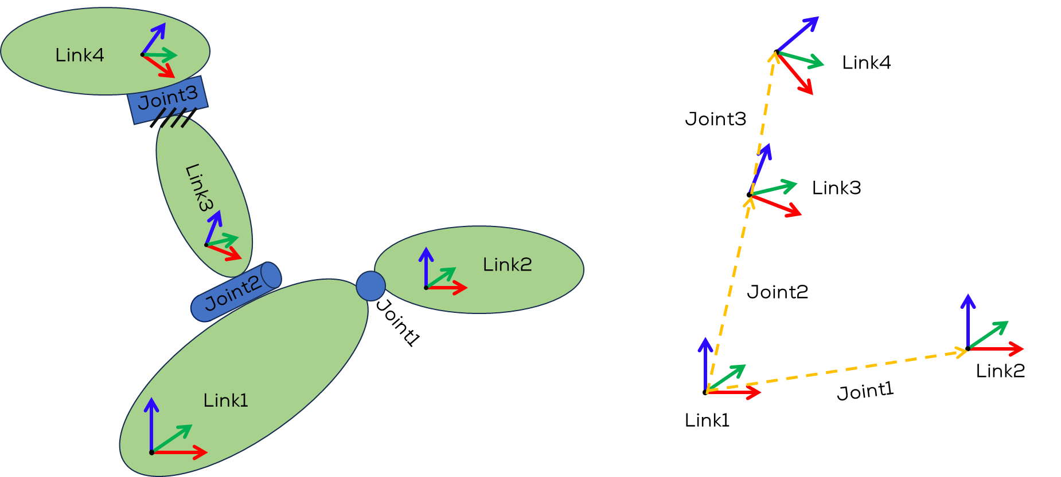
URDF Files
URDF files provide a standardised format to describe robot models, allowing simulation and visualisation tools to load and manipulate robots accurately.
They are widely used in the robotics community and play a crucial role in developing and integrating robotic systems.

Slide 5
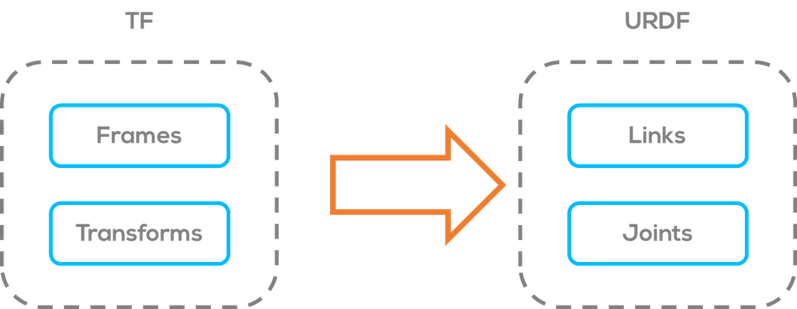
URDF Files
URDF describes a robot as a tree of links, that are connected by joints.
The links represent the physical components of the robot, and the joints represent how one link moves relative to another link, defining the location of the links in space.
This concept can be related to the TF (Transforms) concepts of frames and links as follows
Frames -> Links
Transforms -> Joints

Slide 6
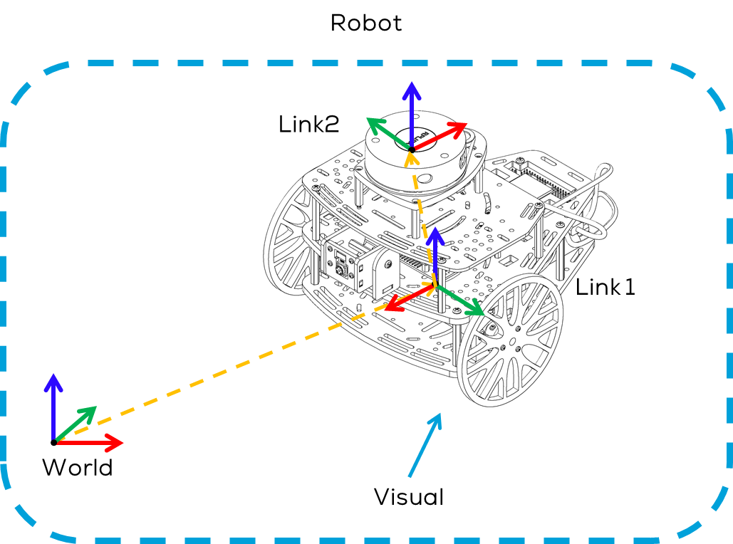
URDF Files
Contents
Robot: The root element of the URDF file, representing the entire robot. It encapsulates all the other elements.
Links: A link represents a rigid body or a component of the robot. It describes the visual, inertial, and collision properties of the link. Each link may have one or more visual and collision elements associated with it.
Visual: Defines the visual appearance of a link, including its geometry (shape), material properties (e.g., color, texture), and transformation (position and orientation) relative to the link.

Slide 7
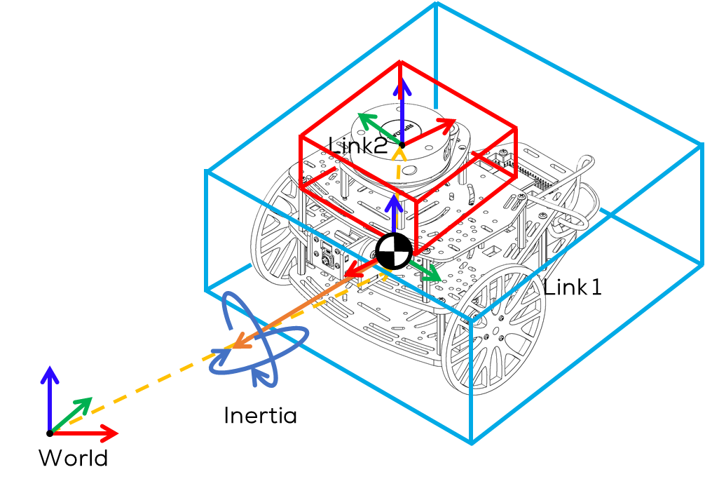
URDF Files
Contents
Collision: Specifies the collision properties of a link, such as the collision geometry and its transformation relative to the link.
Inertial: Describes the inertial properties of a link, such as mass, center of mass, and moments of inertia. These properties are used for dynamics calculations.

Slide 8
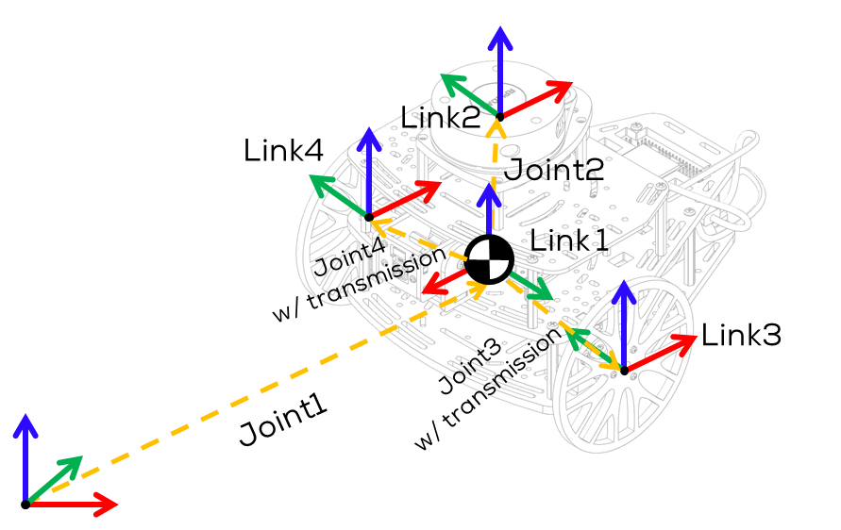
URDF Files
Contents
Joints: Joints define the kinematic connections between links. They specify the type of joint (e.g., revolute, prismatic) and its properties (e.g., limits, axis, origin).
Transmission: A transmission element connects a joint to an actuator, specifying how the joint motion is driven.
Plugins: URDF supports plugins, allowing users to extend the capabilities of the robot description. Plugins can provide additional features like custom collision checking or dynamic properties.

Slide 9
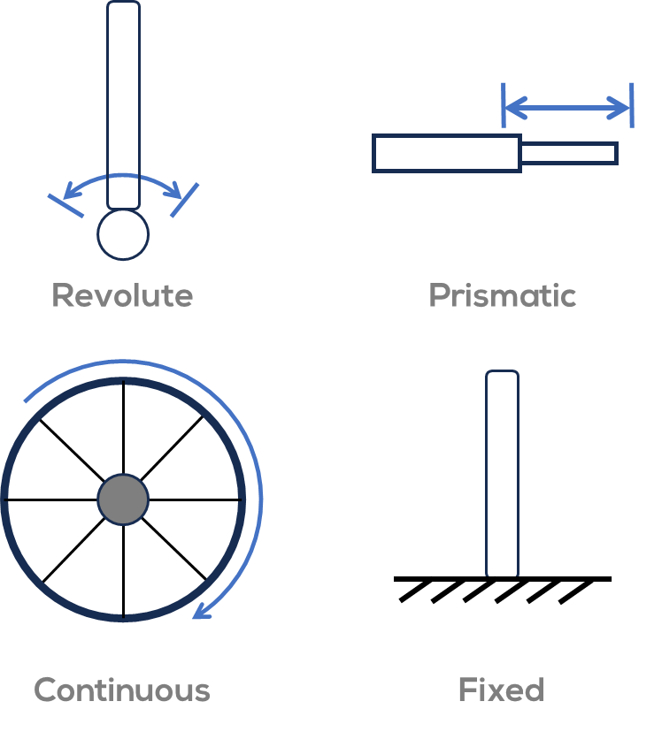
URDF Files: Joints
Revolute - A rotational motion, with minimum/maximum angle limits.
Continuous - A rotational motion with no limit (e.g. a wheel).
Prismatic - A linear sliding motion, with minimum/maximum position limits.
Fixed - The child link is rigidly connected to the parent link. This is what we use for those “convenience” links.
*Some other joints might be available (some deprecated). Some only work on Gazebo.

Slide 10
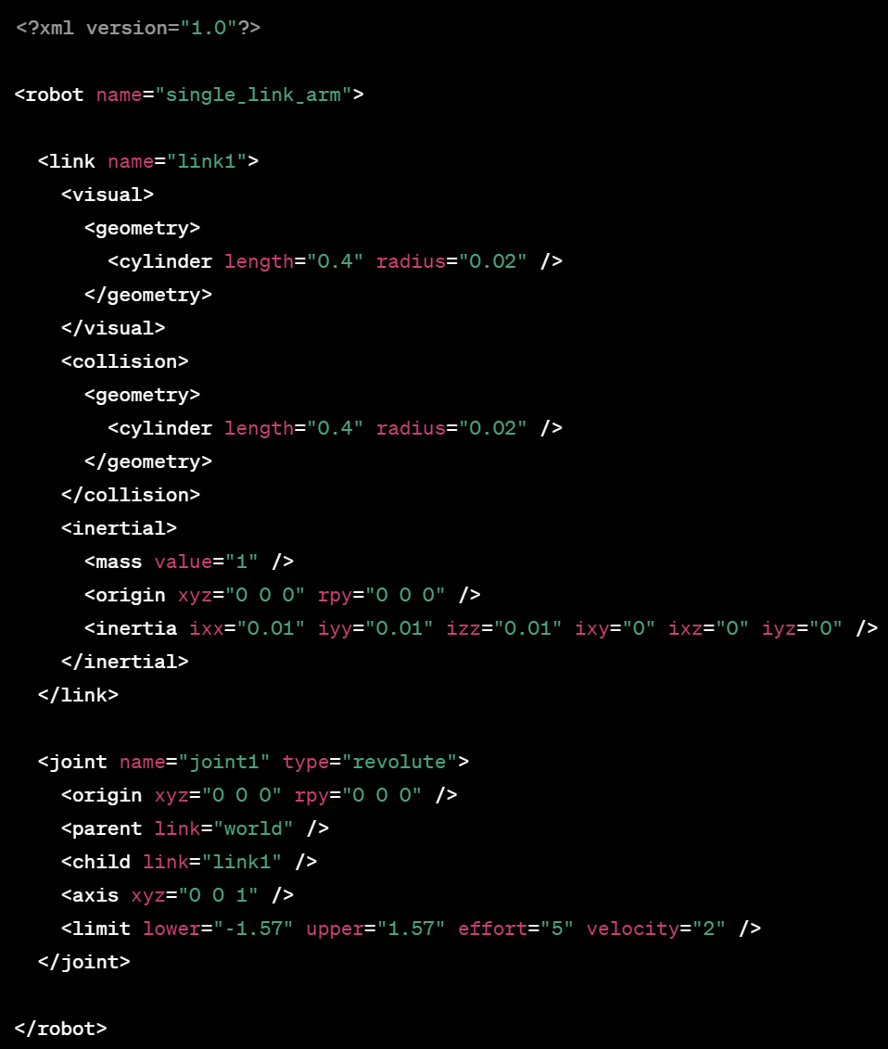
Syntax
XML Declaration: The file begins with an XML declaration that specifies the version of XML being used. For URDF, it is typically <?xml version="1.0"?>.
Root Element: The root element of the URDF file is <robot>. It encapsulates all the other elements in the file and typically includes attributes like name to specify the robot's name.
Links: Inside the <robot> element, you define the robot's links using the <link> element. Each <link> represents a component or a rigid body of the robot. It may have attributes like name.

Slide 11
Syntax
Visuals: Within each <link>, you can define the visual properties using the <visual> element. It includes attributes like names and contains child elements to describe the visual geometry, material properties, and transformations.
Collisions: Similar to visuals, collisions are defined using the <collision> element within each <link>. It represents the collision geometry and properties associated with a link.
Inertial: The <inertial> element is used to specify the inertial properties of a link. It includes child elements such as <mass> to define the mass, <inertia> to specify the moments of inertia, and <origin> to describe the position and orientation of the inertial frame.

Slide 12
Syntax
Joints: Joints are defined within <robot> using the <joint> element. Each joint element represents a kinematic connection between two links. Joints have attributes like name, type, and contain child elements to define properties like limits, axis, and origin.
Transmission: The <transmission> element connects a joint to an actuator, specifying how the joint motion is driven. It includes child elements like <type>, <joint> (to specify the joint being controlled), and <actuator> (to define the actuator properties).
Plugins: URDF supports plugins for extending its capabilities. Plugins are added as <plugin> elements within the relevant sections of the URDF file. They can provide additional features or custom functionality.

Slide 13
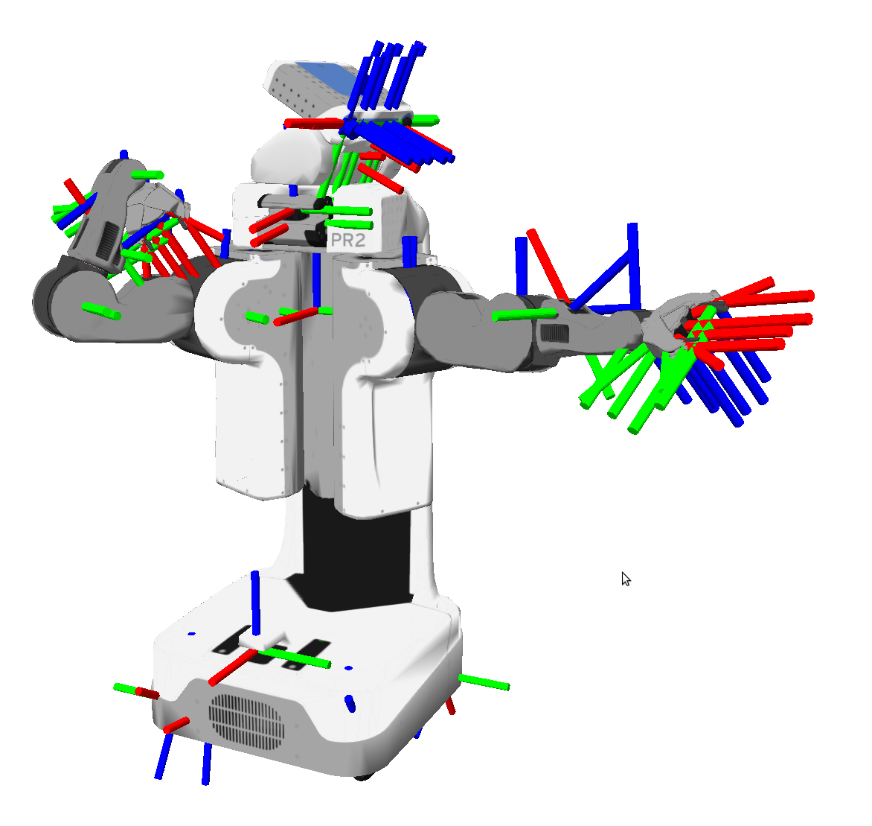
Robot State Publisher
URDF files require a translator, so that ROS can use them.
Different translators have been developed to “translate” URDF files into TF functions.
ROS has different packages to manage URDF files.
To transform the URDF files to robot states, visualise the robot and transform data between different coordinate frames; ROS uses a package called “robot_state_publisher”.
This package allows you to publish the state of a robot to tf2.

Slide 14
Robot State Publisher
Once the state gets published, it is available to all components in the system that also use tf2.
The package takes the joint angles of the robot as input and publishes the 3D poses of the robot links, using a kinematic tree model of the robot.
The package can both be used as a library and as a ROS node.
Usage as a ROS Node:
“robot_state_publisher” uses the URDF specified by the parameter ”robot_description” and the joint positions from the topic ”joint_states” to calculate the forward kinematics of the robot and publish the results via tf2.
<?xml version="1.0"?>
<launch>
<arg name="fixed_joint_test" default="$(find joints_act)/urdf/fixed_ex.urdf"/>
<param name="robot_description" command="cat $(arg fixed_joint_test)" />
<node pkg="robot_state_publisher" type="robot_state_publisher" name="link_ex_pub" >
</node>
</launch>

Slide 15
Activity 1
Creating a simple URDF file

Slide 16
Activity 1
<?xml version="1.0"?>
<robot name="link_example">
<link name="link1" />
<link name="link2" />
<link name="link3" />
<link name="link4" />
<joint name="joint1" type="fixed">
<parent link="link1"/>
<child link="link2"/>
<origin xyz="1 2 1" rpy="0 0 0" />
</joint>
<joint name="joint2" type="fixed">
<parent link="link1"/>
<child link="link3"/>
<origin xyz="-1 -2 -1" rpy="0 0 0" />
</joint>
<joint name="joint3" type="fixed">
<parent link="link3"/>
<child link="link4"/>
<origin xyz="2 1 2" rpy="0 0 -1.57" />
</joint>
</robot>
Make a new package called “joints_act” with the following library packages
geometry_msgs, nav_msgs, rospy, sensor_msgs, std_msgs, tf2_ros, tf_conversions visualization_msgs
Create a “urdf” folder inside the previously created package and a URDF file “fixed_ex.urdf” inside
Paste the following code inside the “fixed_ex.urdf” file.
Code can be found on GitHub.
Create a launch file
catkin_create_pkg joints_act geometry_msgs, nav_msgs, rospy, sensor_msgs, std_msgs, tf2_ros, tf_conversions visualization_msgs
mkdir urdf && touch urdf/fixed_ex.urdf
mkdir launch && touch launch/fixed.launch

Slide 17
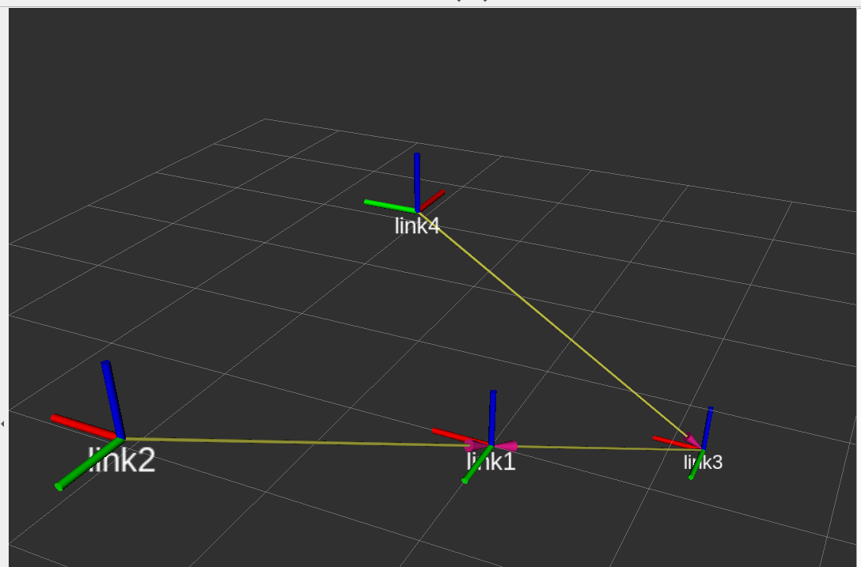
Activity 1
Paste the following code inside the launch file
Add the marker
Press Add
>>By display type>>TF
<?xml version="1.0"?>
<launch>
<arg name="fixed_joint_test" default="$(find joints_act)/urdf/fixed_ex.urdf"/>
<param name="robot_description" command="cat $(arg fixed_joint_test)" />
<node pkg="robot_state_publisher" type="robot_state_publisher" name="link_ex_pub" >
</node>
<node name="rviz" pkg="rviz" type="rviz“ required="true" />
</launch>

Slide 18
Activity 2
Creating a movable joint using URDF

Slide 19
Activity 2
Create a new “urdf” named “continuos_ex.urdf” inside the previously created package “joints_act”
Paste the following code inside the “continuos_ex.urdf” file.
Code can be found on GitHub.
Create a launch file
Add the marker
Press Add
>>By display type>>TF
Run the tf_tree…
Why nothing appears?
touch urdf/ continuos_ex.urdf
<?xml version="1.0"?>
<launch>
<arg name="continuos_ex" default="$(find joints_act)/urdf/continuos_ex.urdf"/>
<param name="robot_description" command="cat $(arg continuos_ex)" />
<node pkg="robot_state_publisher" type="robot_state_publisher" name="continuos_test_pub" >
</node>
<node name="rviz" pkg="rviz" type="rviz" required="true" />
</launch>
touch launch/continuos.launch
rosrun rqt_tf_tree rqt_tf_tree

Slide 20
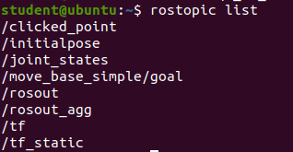
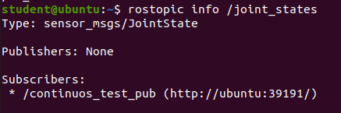
Joint State Publisher
Usually as users, we want to know the “states” of a robot. Internal variables of our robotic system.
The Joint State Publisher is a package in the Robot Operating System (ROS) ecosystem designed to publish joint state information for a robot.
In other words, to always know the position and velocity of each joint.
It's a critical component in ROS for robotics applications because it provides information about the positions and velocities of a robot's joints.
When using non-fixed joints, ROS will not publish the TF information unless they are “used” in other words, something needs to be subscribed or to publish into the /joint_state topic.

Slide 21
Joint State Publisher
This package publishes sensor_msgs/JointState messages for a robot.
The package reads the robot_description parameter from the parameter server, finds all of the non-fixed joints and publishes a JointState message with all those joints defined.
This information is crucial for various tasks, such as kinematic control, trajectory planning, and simulation
Remember!
The joint state publisher is dedicated to read and publish the state of a robot (real or simulated in Gazebo)
When testing our robot, in RVIZ, the joint_state_publisher allows us to make a simple test by publishing into the Joint topic and moving the Joint; this however is only for testing purposes and should not be used when reading real data, since it is only for publication purposes.

Slide 22
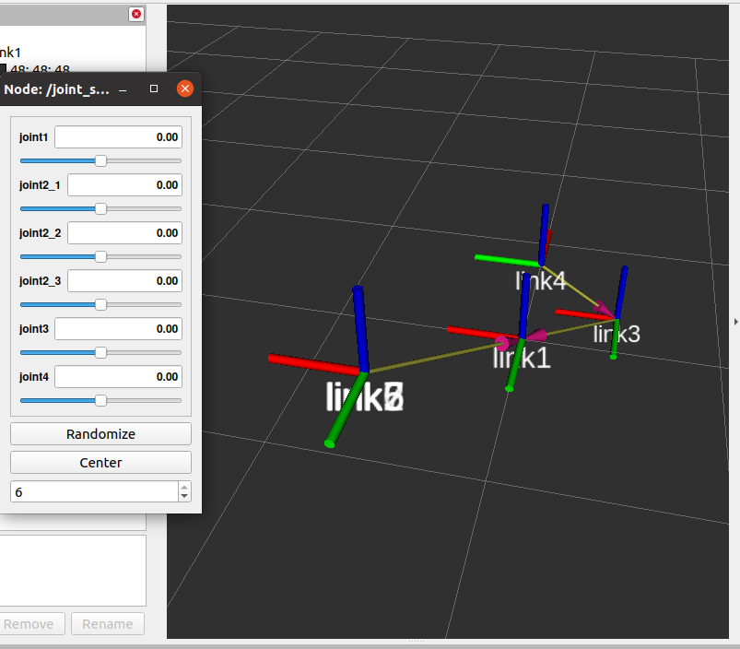
Activity 2
Change the launch file to add the joint state publisher
<?xml version="1.0"?>
<launch>
<arg name="continuos_ex" default="$(find joints_act)/urdf/continuos_ex.urdf"/>
<param name="robot_description" command="cat $(arg continuos_ex)" />
<node pkg="robot_state_publisher" type="robot_state_publisher" name="continuos_test_pub" >
</node>
<node name="joint_state_publisher_gui" pkg="joint_state_publisher_gui" type="joint_state_publisher_gui">
</node>
<node name="rviz" pkg="rviz" type="rviz" required="true" />
</launch>

Slide 23
Thank you

Slide 24
T&C
Terms and conditions

Slide 25
Terms and conditions
THE PIECES, IMAGES, VIDEOS, DOCUMENTATION, ETC. SHOWN HERE ARE FOR INFORMATIVE PURPOSES ONLY. THE DESIGN IS PROPRIETARY AND CONFIDENTIAL TO MANCHESTER ROBOTICS LTD. (MCR2). THE INFORMATION, CODE, SIMULATORS, DRAWINGS, VIDEOS PRESENTATIONS ETC. CONTAINED IN THIS PRESENTATION IS THE SOLE PROPERTY OF MANCHESTER ROBOTICS LTD. ANY REPRODUCTION, RESELL, REDISTRIBUTION OR USAGE IN PART OR AS A WHOLE WITHOUT THE WRITTEN PERMISSION OF MANCHESTER ROBOTICS LTD. IS STRICTLY PROHIBITED.
THIS PRESENTATION MAY CONTAIN LINKS TO OTHER WEBSITES OR CONTENT BELONGING TO OR ORIGINATING FROM THIRD PARTIES OR LINKS TO WEBSITES AND FEATURES IN BANNERS OR OTHER ADVERTISING. SUCH EXTERNAL LINKS ARE NOT INVESTIGATED, MONITORED, OR CHECKED FOR ACCURACY, ADEQUACY, VALIDITY, RELIABILITY, AVAILABILITY OR COMPLETENESS BY US.
WE DO NOT WARRANT, ENDORSE, GUARANTEE, OR ASSUME RESPONSIBILITY FOR THE ACCURACY OR RELIABILITY OF ANY INFORMATION OFFERED BY THIRD-PARTY WEBSITES LINKED THROUGH THE SITE OR ANY WEBSITE OR FEATURE LINKED IN ANY BANNER OR OTHER ADVERTISING.

